Slide 1

HEART DISEASE
PREDICTION
Name: Kehinde Olukosi
Group: 3MTT C2 Data Science(105)
Mentor Name: Odunayo Babatope

Slide 2
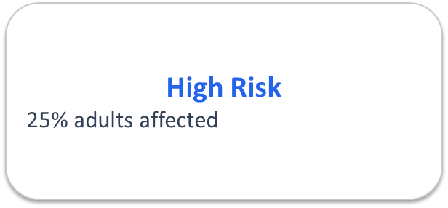
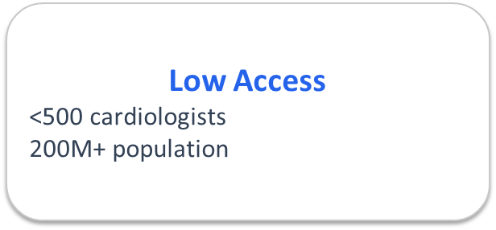
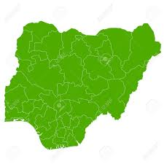
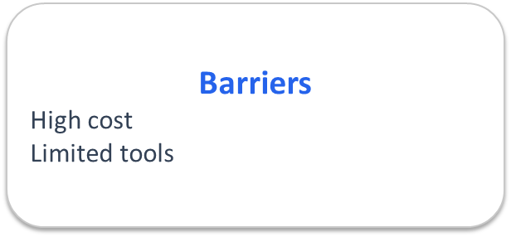
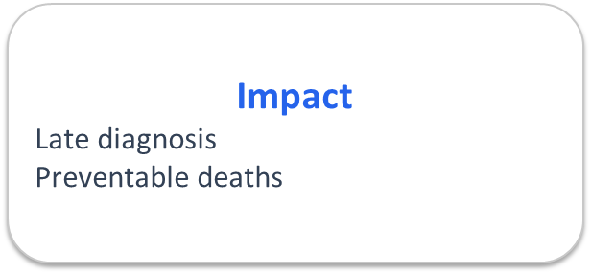
Heart Disease in Nigeria
PROBLEM STATEMENT
🩺
💸
🕒

Slide 3
AI-POWERED HEART DISEASE PREDICTION WEB APP
PROJECT OVERVIEW
🌐 Accessible on the web
🩺 No specialized equipment needed
🔍 Explainable AI insights
👨‍⚕️ Final diagnosis by physician

Slide 4
TECHNICAL FEATURES/TOOLS
THE DATA
PROGRAMMING LANGUAGE
MODEL
APP
EDA
UCI Heart Disease Dataset
Python
Pandas
Seaborn
Numpy
Matplotlib
Sklearn
Random Forest Classifier
Joblib
Streamlit

Slide 5
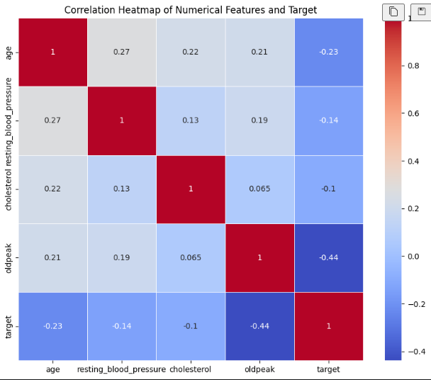
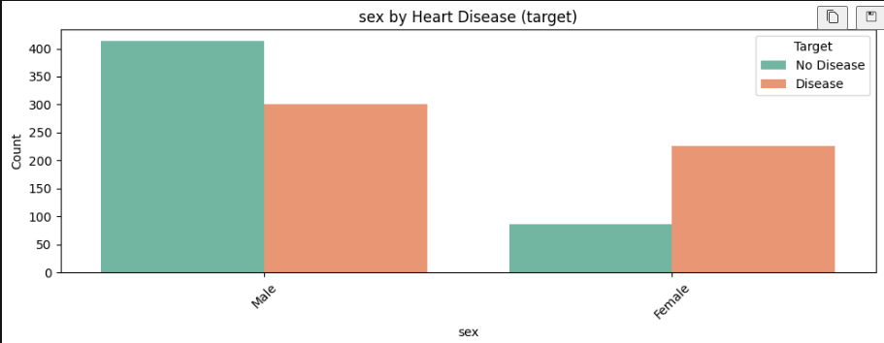
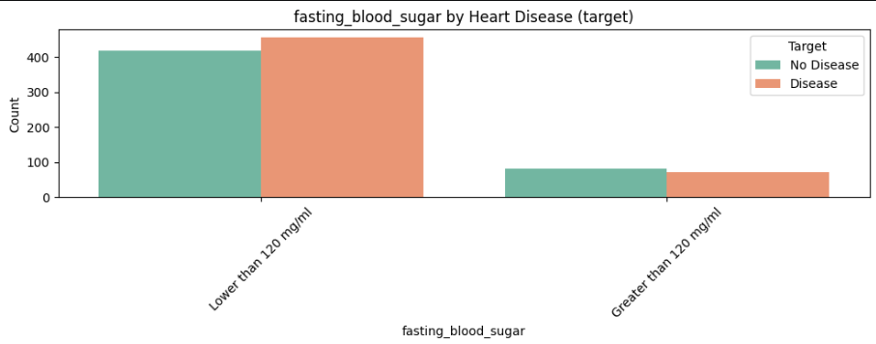
INSIGHTS FROM EXPLORATORY DATA ANALYSIS (EDA)

Slide 6
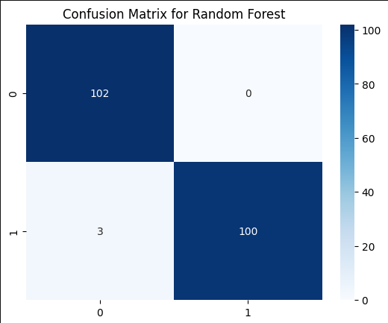
MODEL EVALUATION
Random Forest Classification Report
Precision | Recall | f1-score
1.00 | 0.97 | 0.99
ROC AUC Score: 0.98
Accuracy: 0.9854

Slide 7
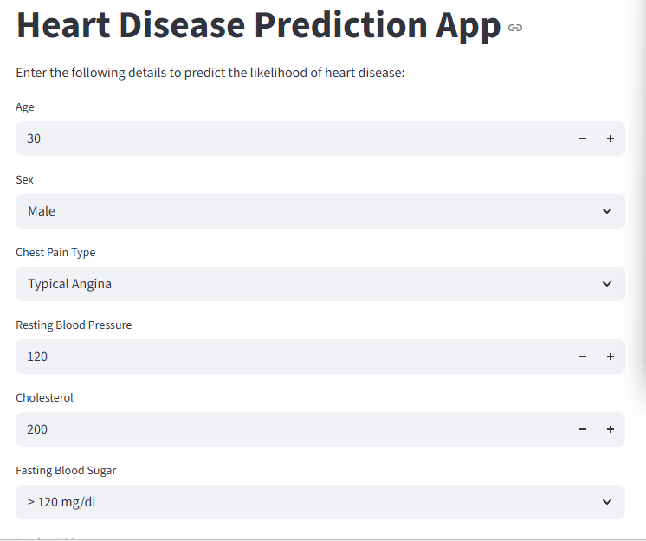
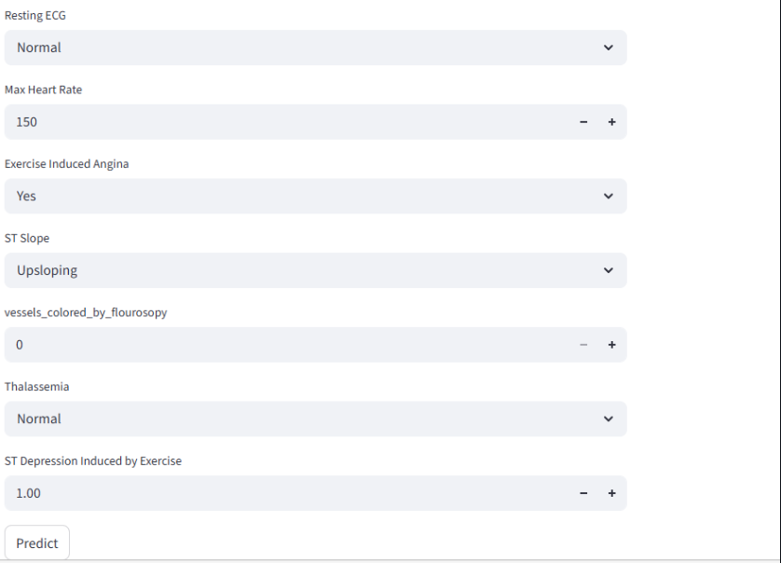
THE APP

Slide 8
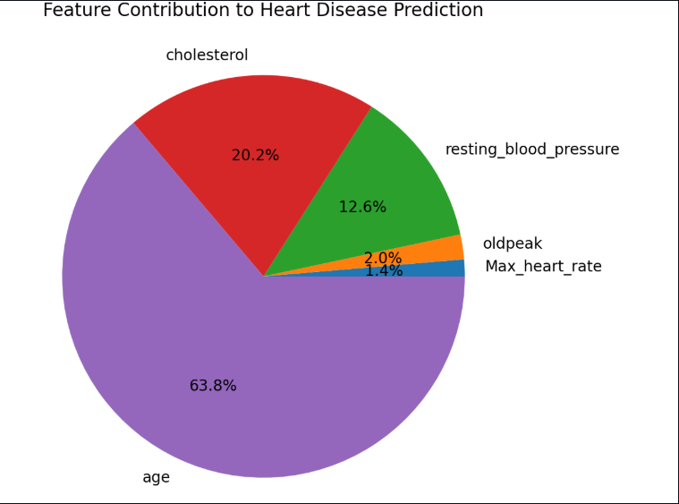
Features Contributing to the Prediction

Slide 9
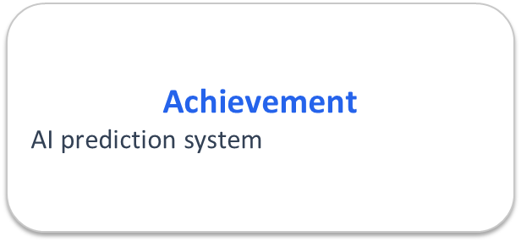
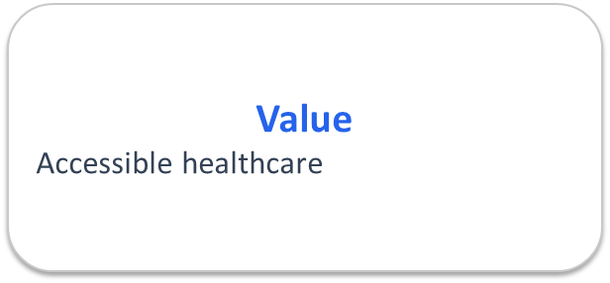
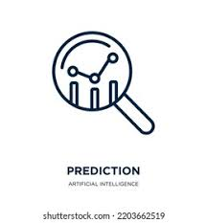

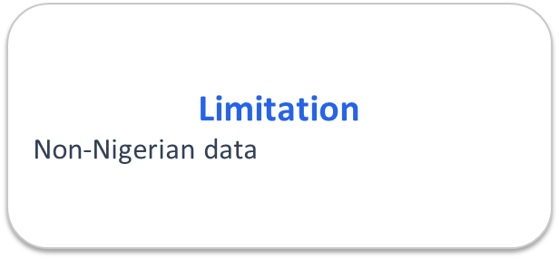
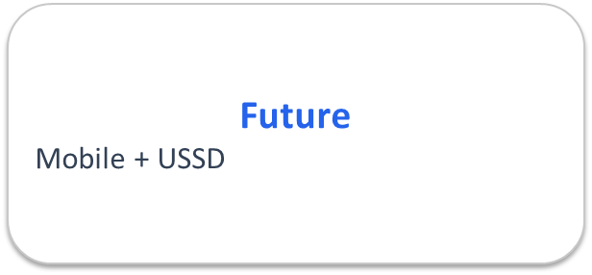



CONCLUSION
📈
💎
💎
💎
🚧

Slide 10

THANK YOU
Kehinde Olukosi | kenoladanolu@gmail.com

